Slide 1
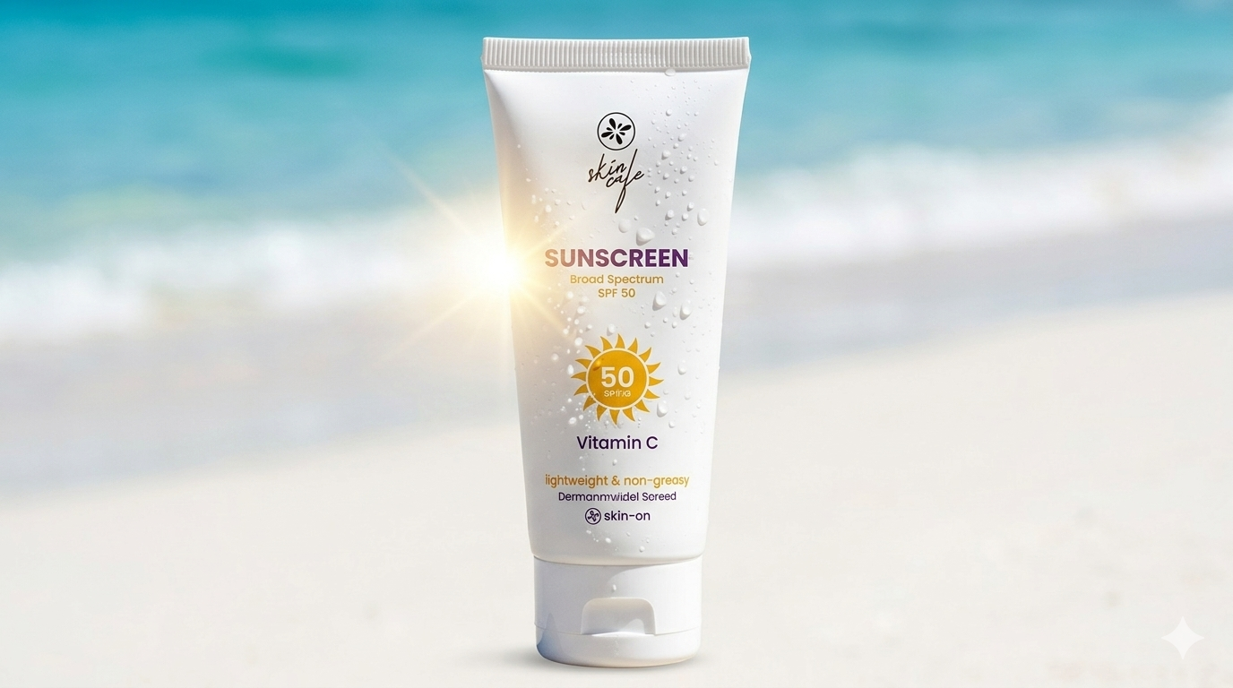


Skin Cafe Sunscreen Marketing Strategy
A Trust-Driven Marketing Strategy to Make
Sunscreen a Daily Habit

Slide 2







Problem Identification
Market Challenges:
Core Problem:
Poor skincare literacy- long term care undervalued
Saturated Market -Crowded field, foreign control, little room to stand out
Consumer Looks for cheaper alternatives- turning premium positioning into adoption hurdles
Consumers distrust local premium sunscreens, favor foreign brands, and see sunscreen as optional rather than essential
Trust Barriers
Widespread fake cosmetics have made consumers skeptical for all brands especially local ones.
Consumer perceive local skincare as risky, not reliable

Slide 3


Situation Analysis
Where we are
Where we want to be
Trust gap toward local skincare brands
Market dominated by foreign skincare brand
Low male participation in skincare
Low awareness about UV protection
Strong trust toward local skincare brands
Skin Cafe positioned as a trusted alternative to foreign brands
Higher male engagement in sunscreen usage
Increased awareness about daily UV protection and sunscreen benefits
ANALYSIS
PLANNING
EXECUTION
EVALUATION

Slide 4


Consumer Analysis
Target Consumers
Buying Behavior
Age Group: 18–30
Urban & semi-urban youth
Social media-driven consumers
Students and young professionals
Trust influencer and peer reviews before purchase
Compare local brands with foreign alternatives
Highly price-sensitive but quality-conscious
ANALYSIS
PLANNING
EXECUTION
EVALUATION

Slide 5


Trust Barrier and Market Challenges
Trust Barriers
Strong perception that foreign brands are safer
and more effective
Fear of counterfeit and low-quality skincare products
Limited trust in locally manufactured cosmetics
Lack of scientific skincare awareness among consumers
Market Challenges
Highly competitive skincare market
Consumers highly sensitive to price
Sunscreen still not part of daily routine
Difficulty differentiating local brands from competitors
ANALYSIS
PLANNING
EXECUTION
EVALUATION

Slide 6





Trust Building Strategy
Get Doctor to Say it works
Prove of quality
Show lab certification
Highlight ingredient transparency
Mention quality testing process
Share source of ingredients
Feature dermatologist recommendations
Show clinical study results
Highlight medically approved ingredients
Breaking the Myths
Using Real Reviews
Address safety concerns
Provide scientific evidence
Answer common customer
questions
Share verified customer reviews
Use video testimonials
Highlight ratings and success stories
ANALYSIS
PLANNING
EXECUTION
EVALUATION

Slide 7

Campaign Strategy
Tag Line
রোদ থাকুক বাইরে,
সুরক্ষা থাকুক ত্বকে
ANALYSIS
PLANNING
EXECUTION
EVALUATION

Slide 8
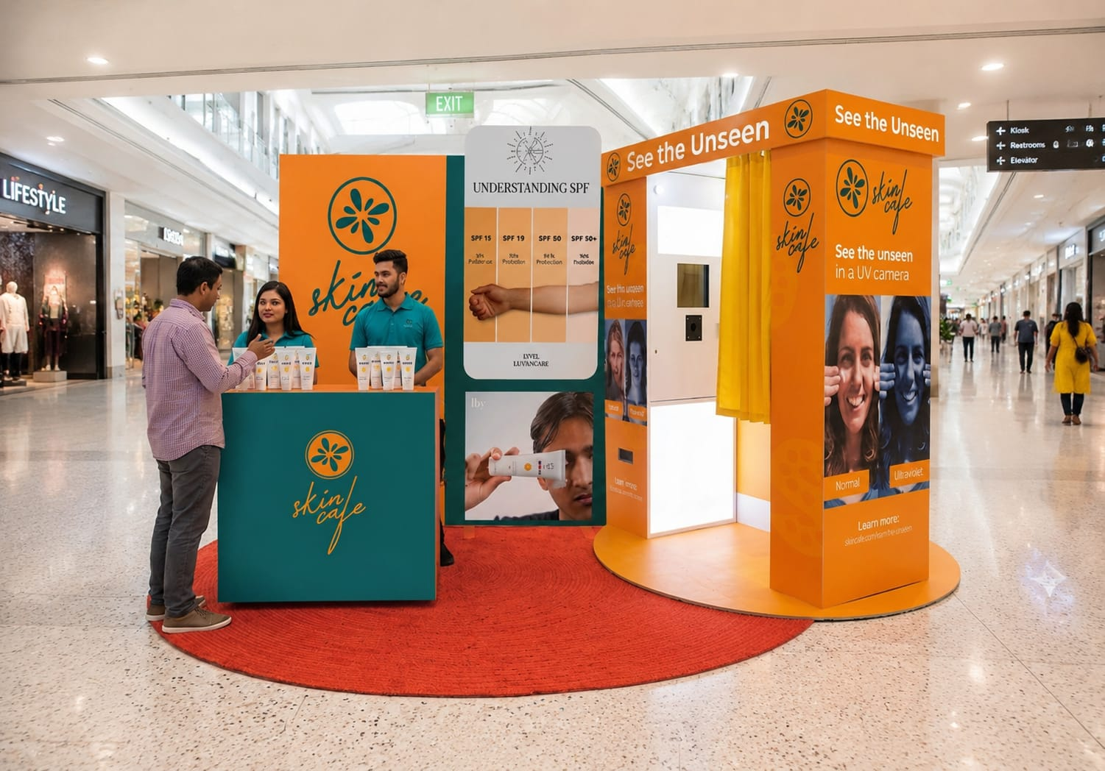
Campaign
See The Unseen Campaign Addresses the low consumer awareness and “Sunscreen is only for summer” misconceptions by physically proving UV damage

Slide 9
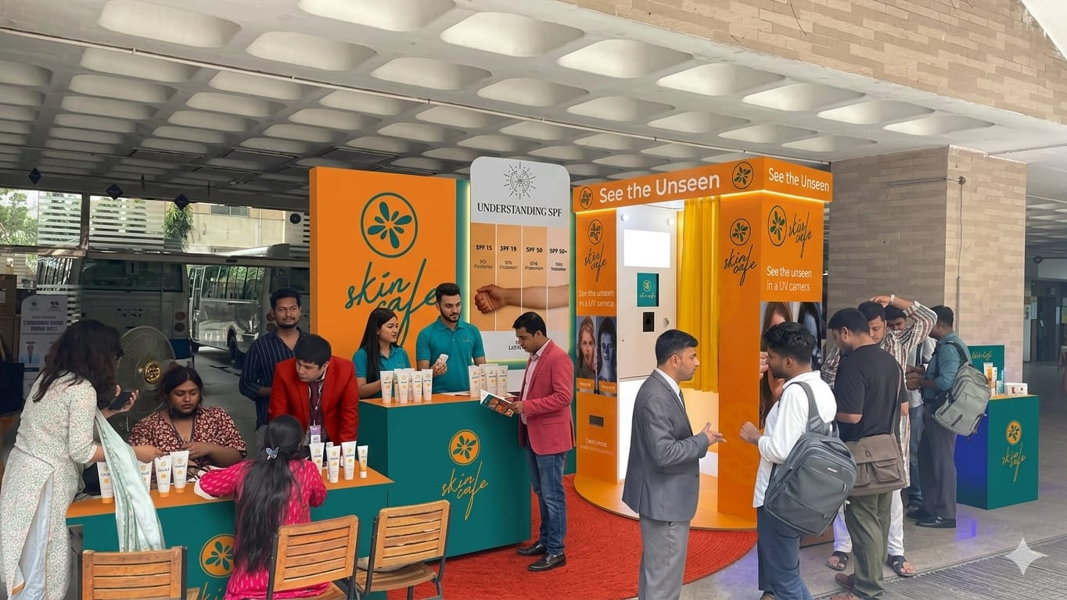
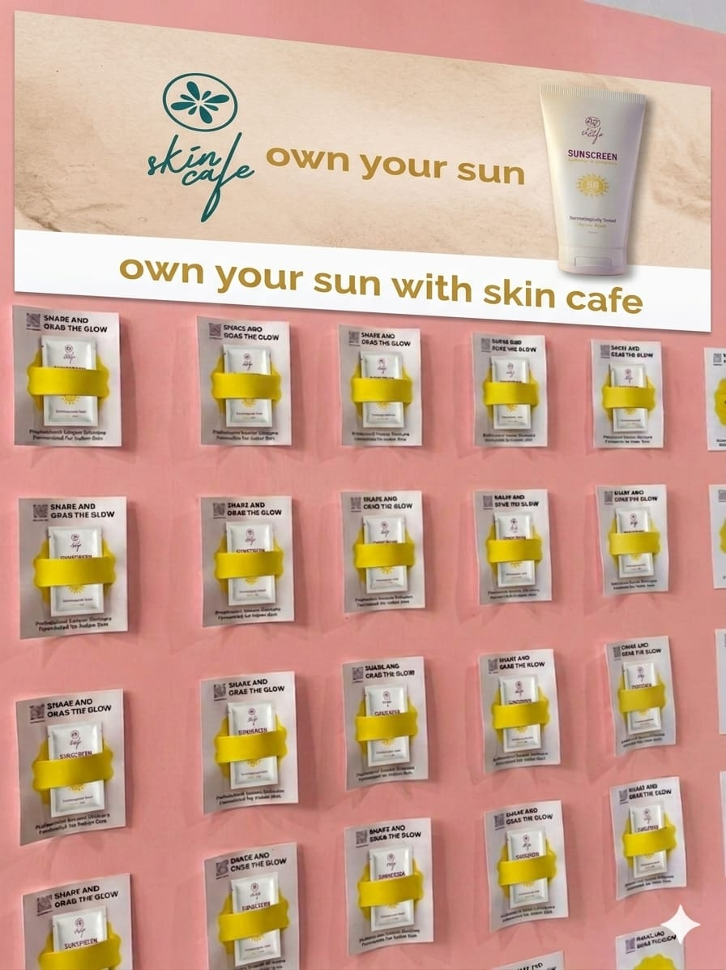

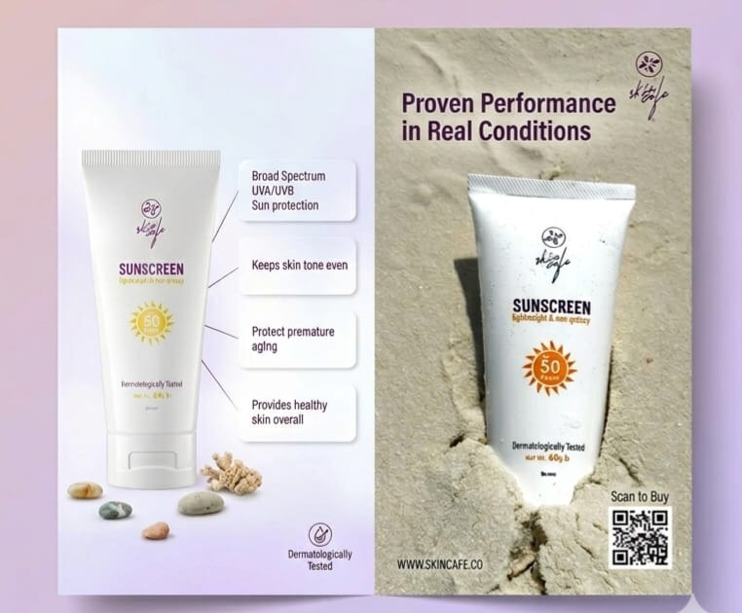
Campaign
Raise awareness about sun damage in different areas with a dermatologist-led UV skin test booth. Educate participants and give them goodies, leaflets
UV Selfie Gift:
The most creative selfie wins a 6 month 30% discount card for anything at Skin Cafe. Winners are announced Second and Fourth #FunFriday of the month. Cards are delivered online with the discount timeline.
“Peel And Protect”
Wall
Flyer Marketing

Slide 10
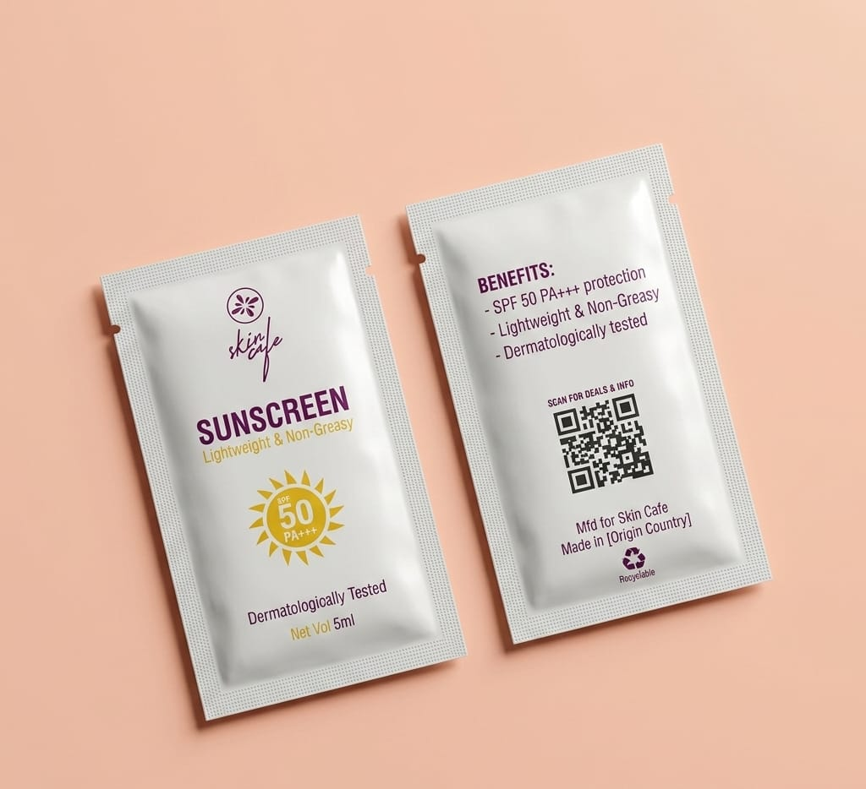
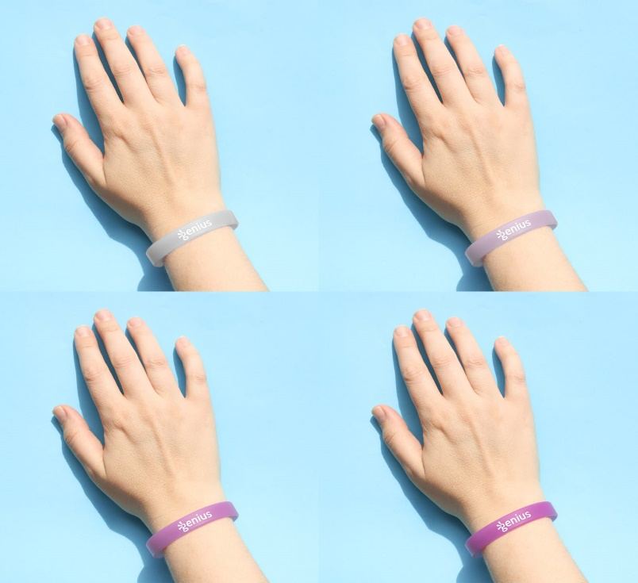
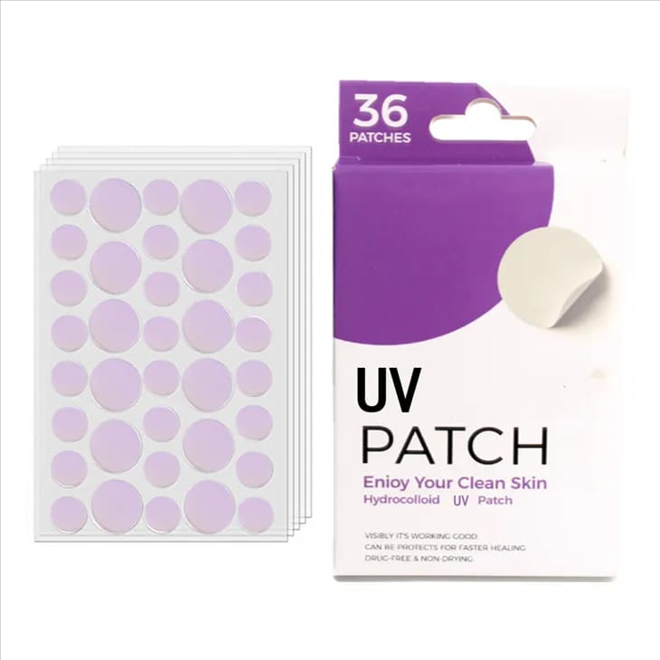
Goodies Distribution
5ml Single use sample sachet
Silicon Bands that changes color when exposed to harsh UV Light
Mini UV Detection Stickers

Slide 11
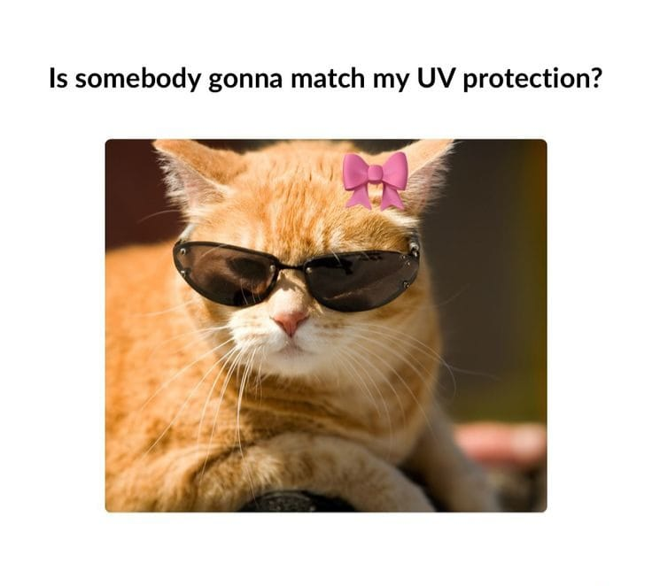
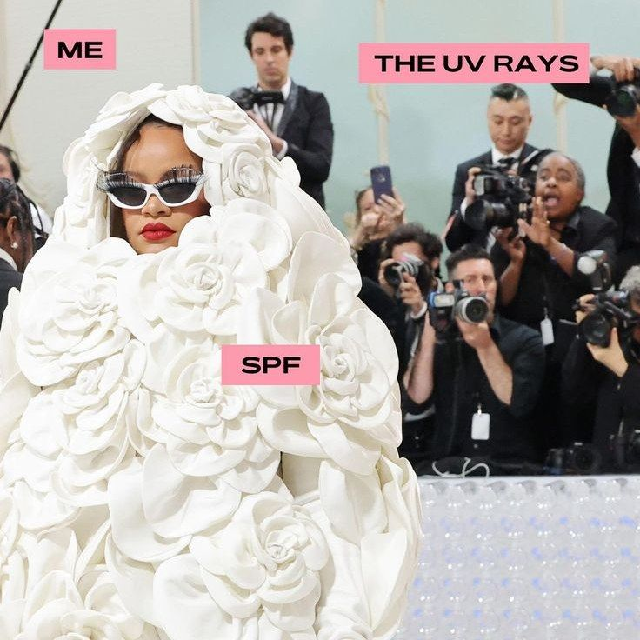
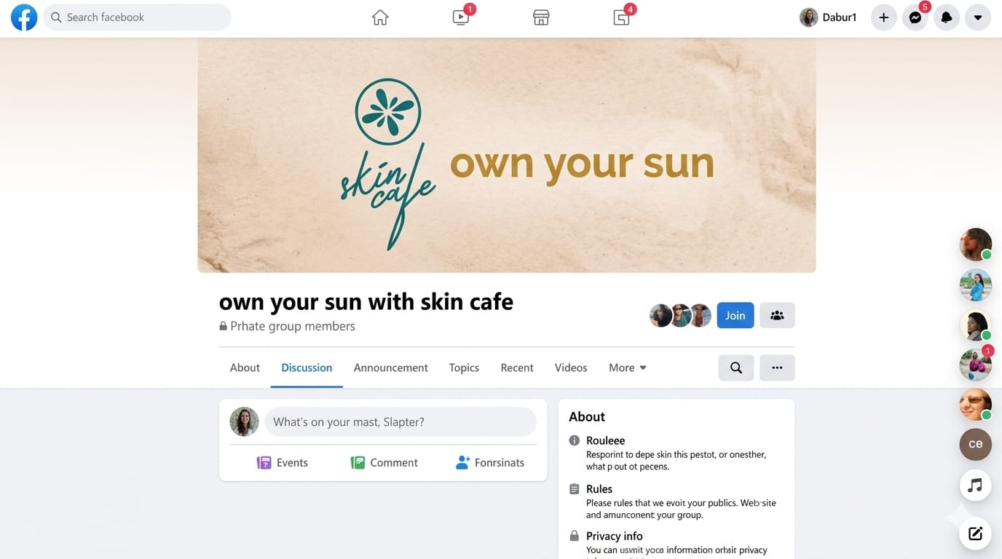
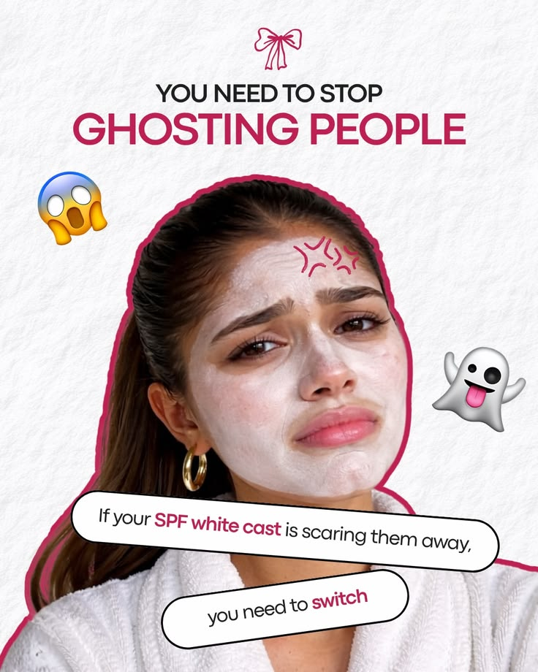
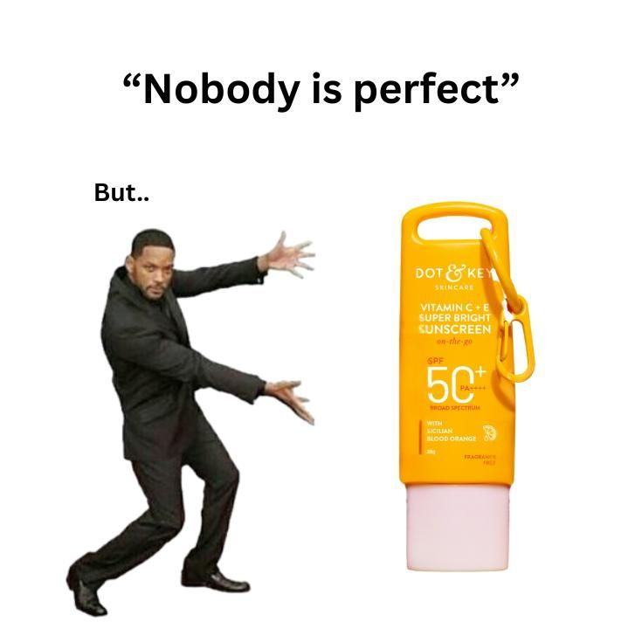
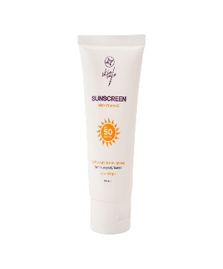
Facebook Community Building
Content Engine:
Sharing memes and realism
Interactive Polls
Skincare tips

Slide 12
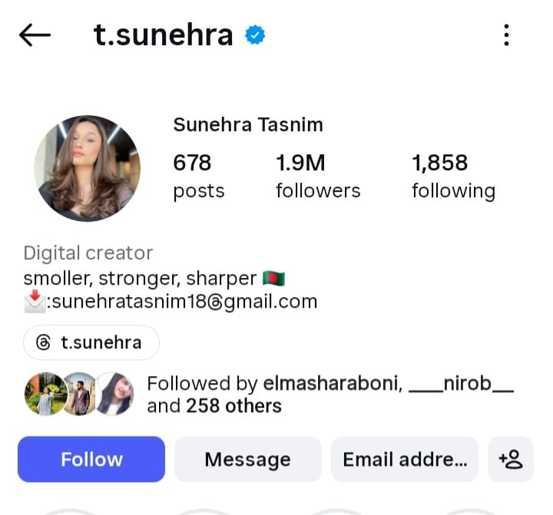
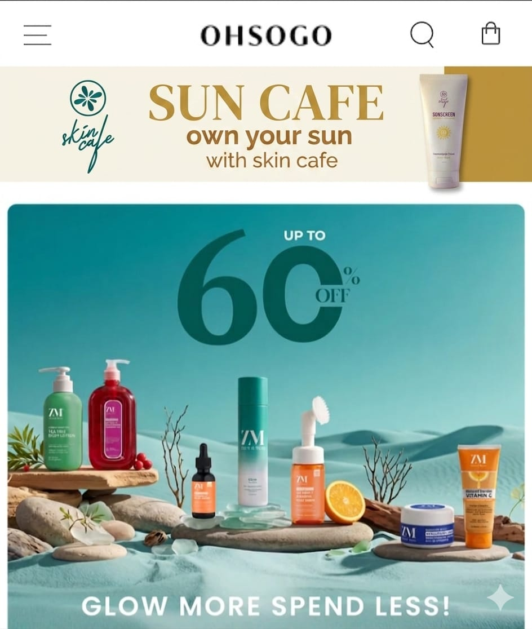
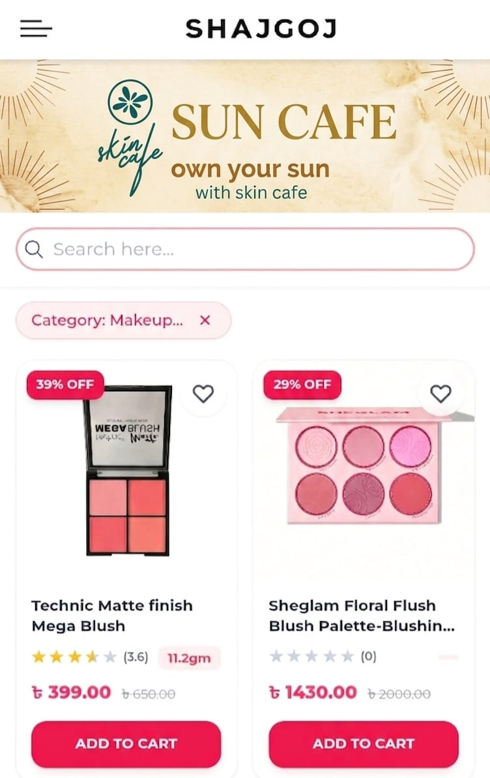
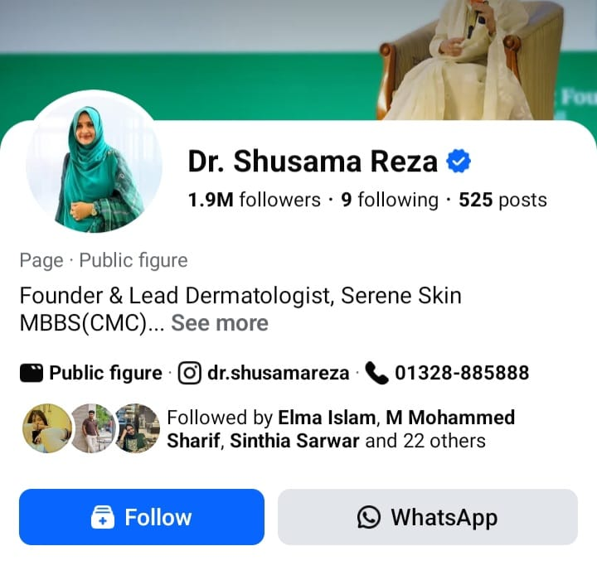
Influencer Marketing
E-Commerce
Target Group based
Influencer marketing
GDN Banner
Beauty
Health

Slide 13
12-Month Roadmap
Quarter | Strategic Theme | Product | Price | Place | Promotion
Q1(Jan–Mar) | Trust Building | Sample Packs | Promotional Pricing | Campus Booths | Influencer Reviews
Q2 (Apr–Jun) | Summer Protection | SPF Bundles | Combo Offers | Retail & Online Stores | Social Media Campaign
Q3 (Jul–Sep) | Daily Habit | Travel Size | Loyalty Deals | Retail & Online Stores | Educational Reels
Q4 (Oct–Dec) | Brand Loyalty | Family Packs | Value Bundles | Nationwide Push | Social Work
ANALYSIS
PLANNING
EXECUTION
EVALUATION

Slide 14
Marketing Budget Allocation (sector)
ANALYSIS
PLANNING
EXECUTION
EVALUATION

Slide 15
Challenges & Feasibility
Dominance of Foreign Competitors
Competitive pricing & localized positioning
Low Trust in Local Brands
Science-backed communication & real consumer reviews
Limited UV Protection Awareness
Educational content & awareness campaigns
Low Male Sunscreen Usage
Gender-inclusive campaigns & influencer engagement
ANALYSIS
PLANNING
EXECUTION
EVALUATION

Slide 16
Thank You

